Slide 1
Stat 6430 – R final project

Slide 2
agenda
Introduction
Objectives
Graphs and Analysis
Questions

Slide 3
Objectives
What seems to be associated with a high rating?
What groups are most likely to provide higher ratings?

Slide 4
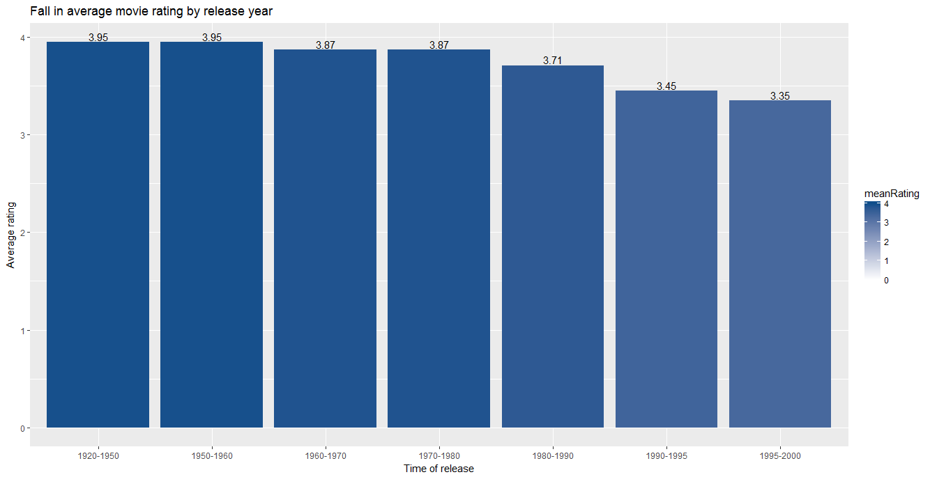

Slide 5
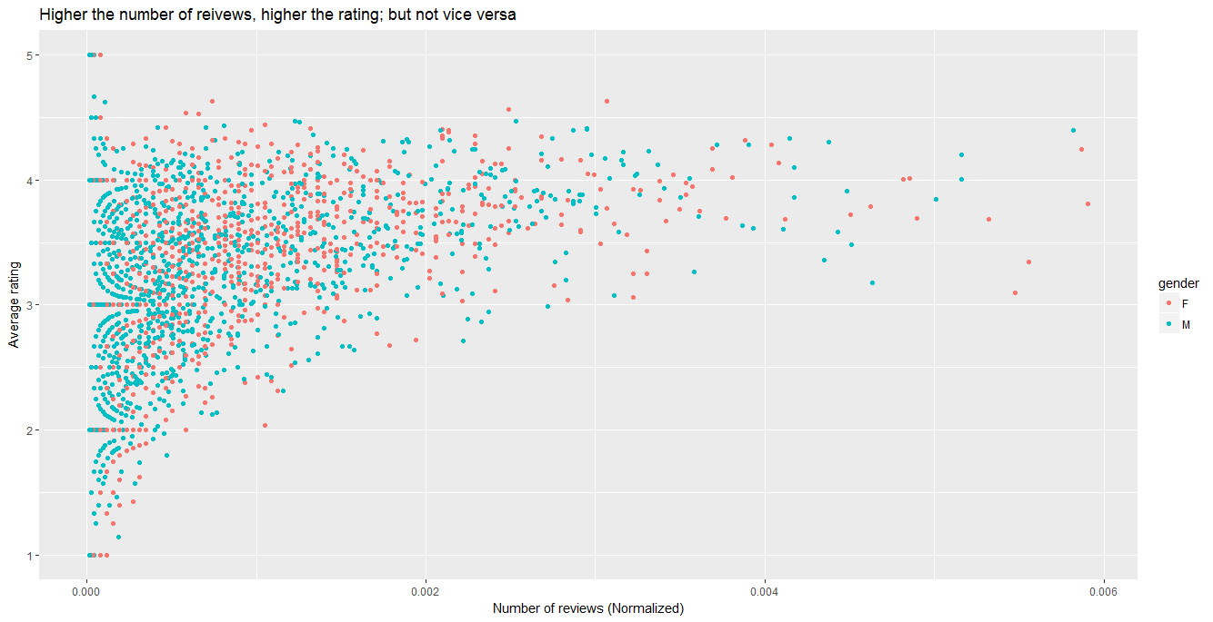

Slide 6
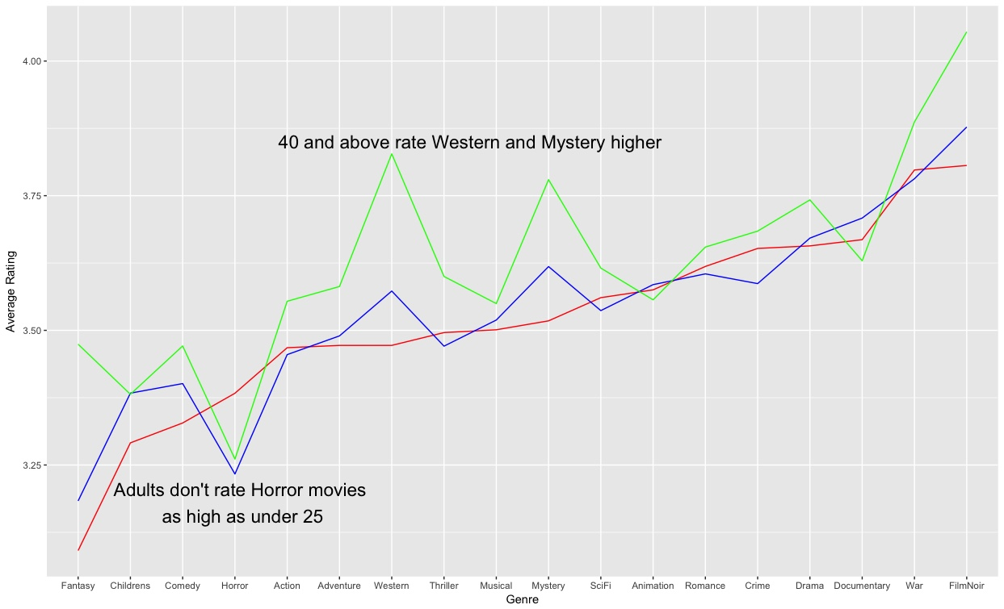
Age 25 and under Age 25 to 40 Age 40 and above

Slide 7
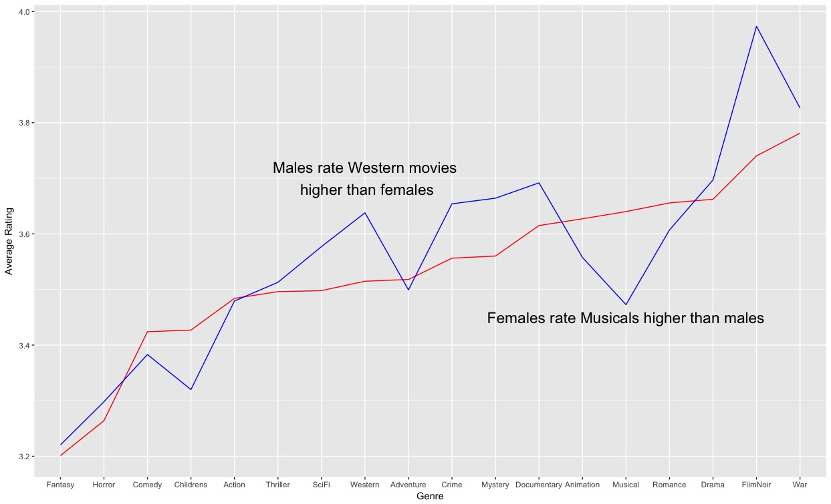
Female Male

Slide 8
Questions?

